Slide 1
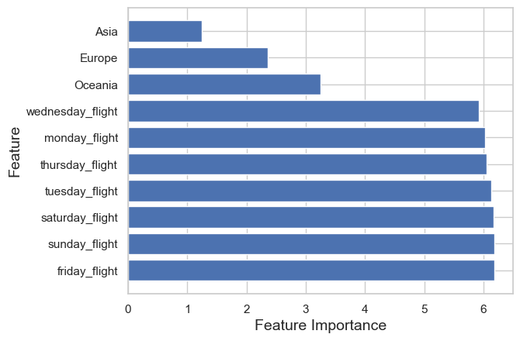
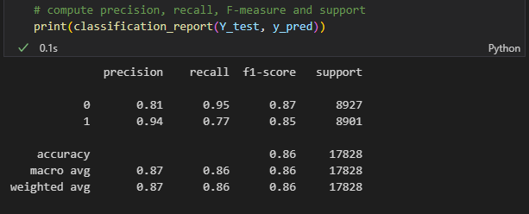
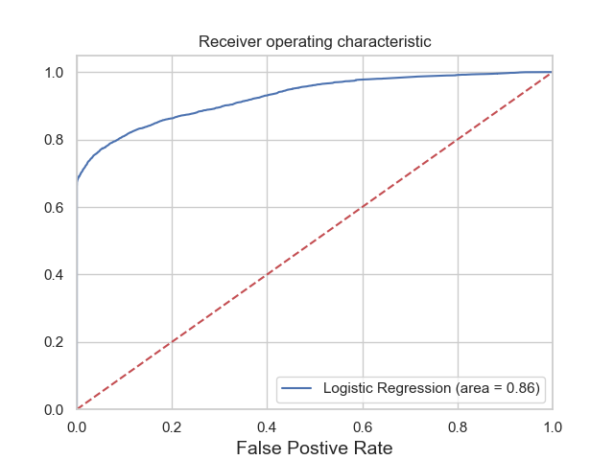
RESULT
From top-right to bottom left, these images shows the level of importance of each feature, the Classification Report of the model and the ROC-AUC curve of the model. Length of stay is the most important feature for the model.

